Slide 1
CEIS 106 Operating Systems
By Marlon Curry

Slide 2
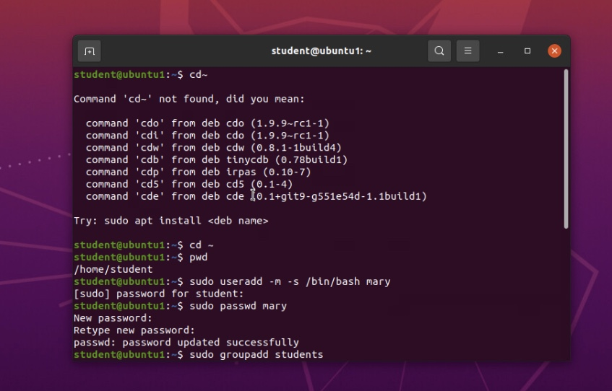
Test user and group settings

Slide 3
Add users and groups in CLI
1. What does the –m option in the useradd command do?
Answer here:-m option in the user add command creates home directory for new user. No home directory will be created without option
2. What does the -3 option in the tail command do?
Answer here:tail command doesn’t have a -3 option. Tail command has a -n option which is used to specify number of lines to be displayed from end of a file.
3. Which line of the /etc/group file lists members of the “students” group? Copy it here.
Answer here:
Students:1002:student.mary

Slide 4
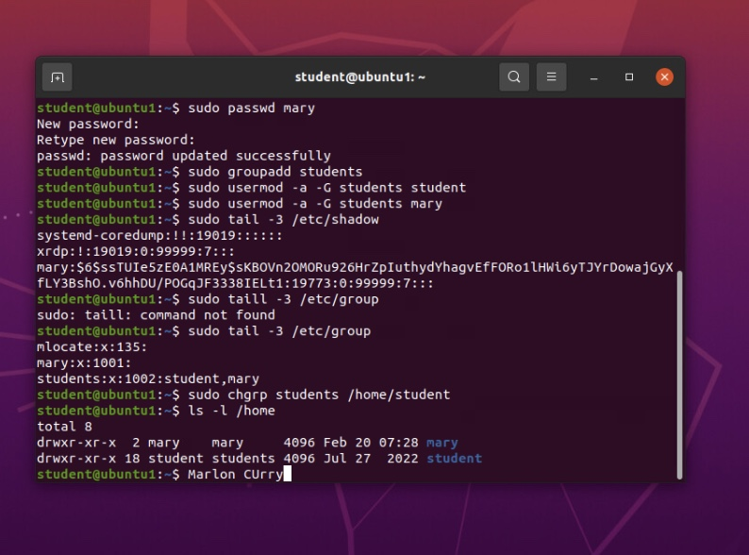
Add users in GUI

Slide 5
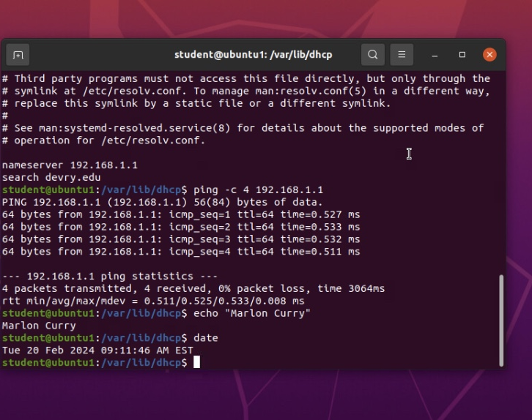
Discover host IP configurations
1. What is the IP address of your Ubuntu machine?
Answer here:192.168.1.107/24
2. What is the IP address of its default gateway?
Answer here:192.168.1.1
3. What is the IP address of its DHCP server?
Answer here:192.168.1.255
4. What is the IP address of its DNS server?
Answer here:192.168.1.1

Slide 6
Manage network interfaces
1. Which DHCP message is shown in the output of the sudo dhclient –v –r ens33 command?
Answer here:
lease
2. Which four DHCP messages are shown in the output of the sudo dhclient –v ens33 command?
Answer here:
eth0

Slide 7
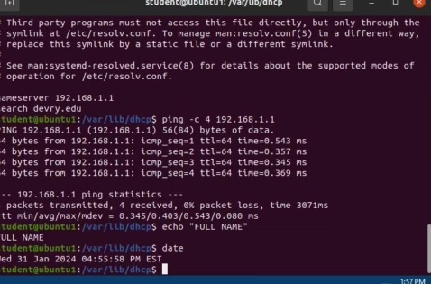
Use network utilities

Slide 8
Monitor Linux processes
1. What is the default action of the 15 SIGTERM kill signal?
Answer here:
terminate
2. In the System Monitor window, click on % CPU to sort the processes by CPU load. Which process shows the highest percentage of CPU usage?
Answer here:
gnome shell

Slide 9
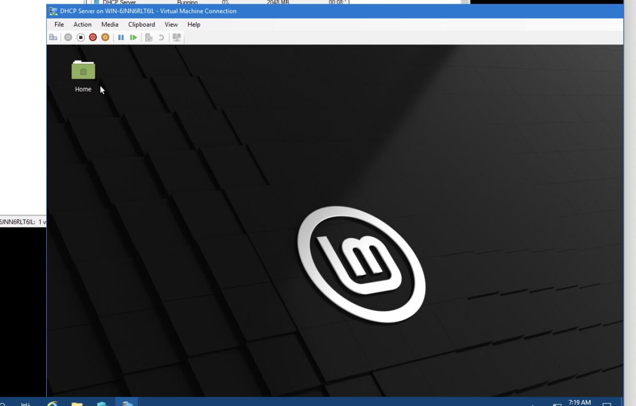
Monitor network bandwidth usage

Slide 10
Monitor user activities
Issue the sudo accton on command to turn on GNC accounting. Run the sudo updatedb command. Enter lastcomm updatedb to check if the updatedb command was executed before. Remember to turn off GNC accounting (sudo accton off) after answering the questions.
1. What flag value is displayed in the output?
Answer here:s
2. Why is the name of the user who ran the processes shown as root, not student?
Answer here:
Apt command ran by superuser

